Slide 1
DIGITAL PORTFOLIO
STUDENT NAME: HAPROOS FATHIMA.R
REGISTER NO AND NMID: 222411299/asunm1737222411299
DEPARTMENT: B.Sc(Computer science)
COLLEGE: VIVEKANANDA VISION ARTS & SCIENCE COLLEGE/ MADRAS UNIVERSITY

Slide 2
PROJECT TITLE showcasing skills through a digital portfolio.

Slide 3


AGENDA
Problem Statement
Project Overview
End Users
Tools and Technologies
Portfolio design and Layout
Features and Functionality
Results and Screenshots
Conclusion
Github Link
3/21/2024 Annual Review

Slide 4
PROGRAM STATEMENT students often struggle to showcase their skills projects and achievements in a structured way. A digital portfolio solves this by providing a personalized platform for presenting ones academic and technical journey.

Slide 5

PROJECT OVERVIEW This project involves creating a customized portfolio website with a professional Design it highlights personal details, skills, projects, and contact information in an interactive and user friendly layout.

Slide 6

WHO ARE THE END USERS ? End users are the people who directly use the product, service, or system for their needs.

Slide 7
TOOLS AND TECHNIQUES Tools and techniques in a digital portfolio are the software, platforms and methods used to create design, and present the portfolio effectively. They help in showcasing skills in a professional way.

Slide 8
PORTFOLIO DESIGN AND LAYOUT
Portfolio design and layout refers to the way content is arranged and presented. A clear organized, and attractive layout marks the portfolio easy to read and professional.
8

Slide 9
FEATURES AND FUNCTIONALITY Features and functionality in a digital portfolio are the elements and interactive options that make it useful, such as navigation, multimedia support, and easy access to information.

Slide 10
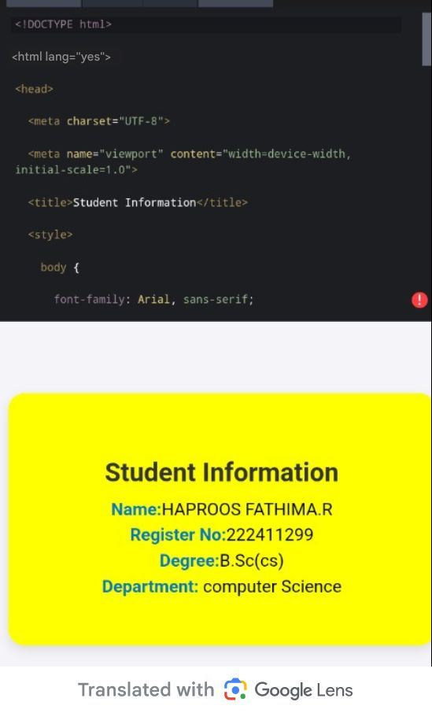
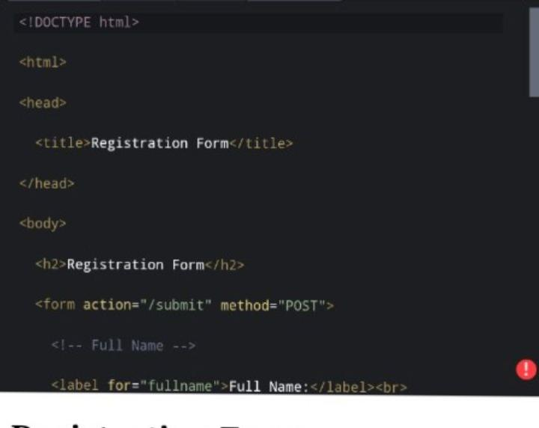
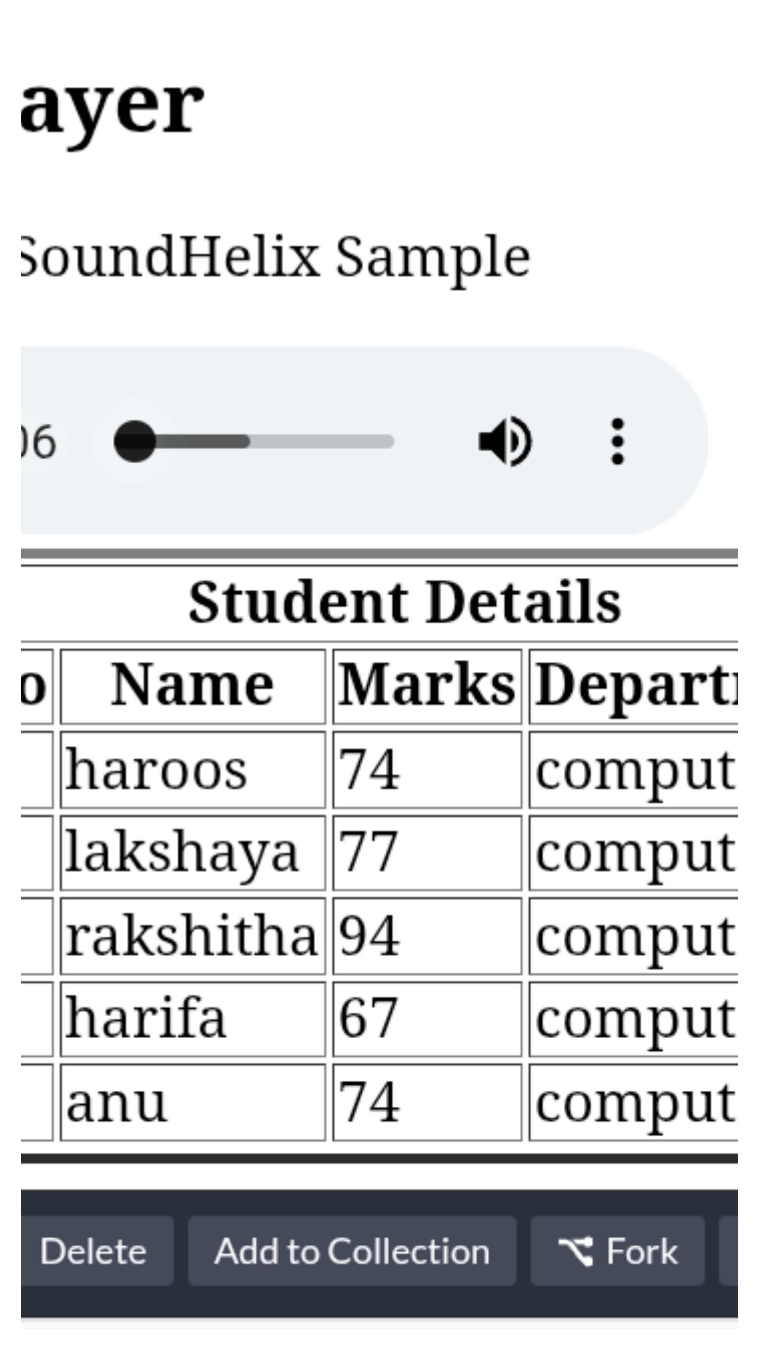
RESULTS AND SCREENSHOT
3/21/2024 Annual Review
10

Slide 11
CONCLUSION The digital portfolio highlights my skills, knowledge, and project outcomes effectively. It serves as evidence of my learning journey and will be helpful for future academic and career opportunities.
11

